Slide 1

Ryvl
Ref: RYVL-TT-2026
See your market.
Not just your store.
Benchmarking pricing, stock-outs, and category positioning across 7 major marketplaces. Deliver actionable clarity to drive margins and capture revenue opportunities.
Anonymized Peer Cohort
Real-Time Signals
Enterprise Grade Privacy
Prepared for: tt
Generated: August 2026 | Confidential

Slide 2

Ryvl
Section 01
Market Position & Core Performance
A high-level summary of your competitive standing, margin protection zones, and priority inventory actions for this operational cycle.
Ryvl Seller Intelligence Platform
Slide 02

Slide 3






Ryvl
Executive Snapshot & Key Signals
REVENUE (30D)
ORDERS HANDLED
PRICE INDEX SCORE
STOCKOUT RISK SKUS
Rs 1,500,450
3
2757.7
0 SKUs
+100.0% vs prior period
+100.0% volume growth
+2657.7% above median
On track
What Changed This Cycle
Recommended Actions
•
Market conditions shifted for tracked categories this cycle.
•
Review pricing on top SKUs against category median.
•
Tracked competitors adjusted pricing across marketplaces.
•
Reorder high-turnover inventory nearing low-stock threshold.
•
Demand velocity detected for top-performing SKUs.
•
Expand watchlist coverage to emerging competitors.
Source: Ryvl Aggregated Commerce Engine
Slide 03

Slide 4


Ryvl
Data Validation & Approval Gate
Backend Draft & Aggregation
Researcher Insights Review
Ryvl continuously collects public marketplace pricing, stock levels, and category metrics. Data is processed through statistical outlier filters to eliminate noise.
Internal analysts review model findings, scrub uncertain competitor data, and strip raw private records. Only anonymized, highly reliable signals enter the final report.
Automated ingestion pipeline running 24/7 across 7 major sales channels.
Ensures strict compliance with enterprise privacy standards.
Client-Safe Export Guarantee
Anything flagged as internal notes or private seller metrics is automatically scrubbed before client PDF/PPTX download.
Ryvl Data Protocol v4.2
Slide 04

Slide 5
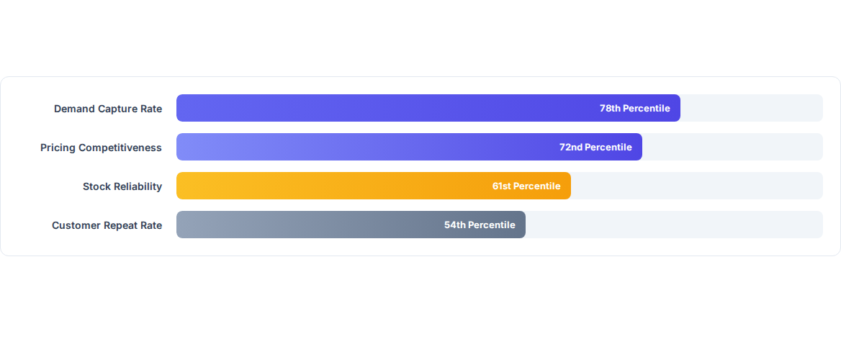
Ryvl
Category Positioning Percentiles
Our percentile breakdown measures your operational metrics against an anonymized cohort of category peers. Higher percentiles reflect stronger relative performance.
* Data compiled from 140+ active marketplace sellers in your product category over the past 30 days.
Anonymized Cohort Analysis
Slide 05

Slide 6



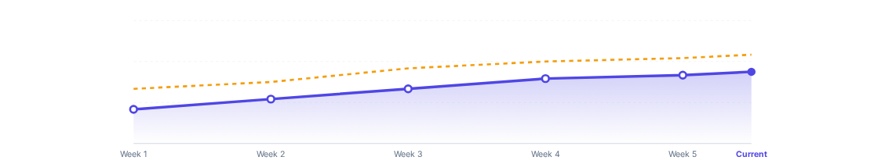
Ryvl
Market Price Trend & Action Band
YOUR CURRENT PRICE
RECOMMENDED OPTIMAL BAND
$24.90
$25.40 – $26.20
— Your Store Price | - - Market Median
Slide 06

Slide 7
Ryvl
Public Marketplace SKU Tracking
Tracked Product SKU | Price Delta | Stock State | Category Signal | Risk Level
Lenovo yoga tab (tb710fu), 12gb 256gb | +539.5% | In Stock | Stable Volume | Low Risk
dell g3 3500 for sell | +829.4% | In Stock | Stable Volume | Low Risk
iPad pro m4 13 inch 0327 6625337 WhatsApp contact | +703.0% | In Stock | Stable Volume | Low Risk
IPAD 9TH GENERATION WITH BOX | +413.0% | In Stock | Stable Volume | Low Risk
Apple iPad 11th Gen (A16 Bionic) 128GB Blue | +680.7% | In Stock | Stable Volume | Low Risk
Public marketplace signals only. Private seller data remains strictly confidential.
Ryvl Automated Crawler Network
Slide 07

Slide 8

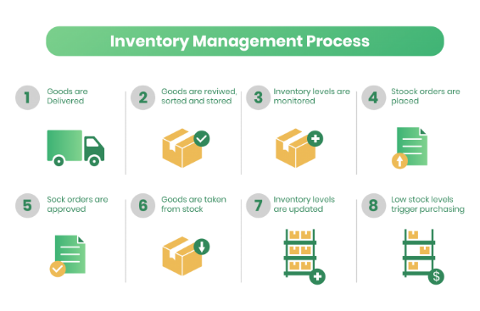
Ryvl
Inventory & Demand Velocity
•
Early Stockout Warnings: Ryvl identifies low-stock velocity 5 to 7 days before total depletion across marketplace fulfillment nodes.
•
Capturing Supply Voids: When key category rivals suffer out-of-stock events, our automated alerts signal optimal price increase windows.
•
Fulfillment Efficiency: Aligning reorder schedules with peak category search volume prevents costly stock pauses.
•
Margin Safety Net: Safeguards your minimum threshold price during automated dynamic repricing campaigns.
Inventory Optimization Module
Slide 08

Slide 9
Ryvl
Product Portfolio Revenue Contribution
Product Line | Revenue Share | Price Index | Stock Risk | Strategic Action
1600 cc | 87% | 13384 | Low | Review pricing - trailing above median
Laptops | 9% | 654 | Low | Review pricing - trailing above median
RTX 4070 Ti | 4% | 2478 | Low | Review pricing - trailing above median
Pepso 1 LTR | 0% | 1 | Low | Raise price range toward category median
Fuel Injectors | 0% | 29 | Low | Raise price range toward category median
Key Insight: Top 2 product lines generate 96% of revenue. Securing inventory for 1600 cc is a priority.
Portfolio Performance Matrix
Slide 09

Slide 10






Ryvl
Customer Health & LTV Strategy
Win-Back Segment
Bundle Expansion
Margin Protection
Identify 0 accounts inactive over the last 30 days. Trigger automated targeted re-engagement offers before complete churn.
1600 cc is a strong candidate for bundling with complementary items in your catalog. Creating bundle kits can help boost average order value.
Limit promotional discount codes strictly to high-LTV at-risk customer cohorts to prevent unnecessary margin erosion.
Target: 18% Recovery
Target: +$3.40 AOV
Target: Protect Gross Margin
Ryvl Customer Analytics Module
Slide 10

Slide 11


Ryvl
Strategic Action Roadmap
PHASE 01
PHASE 02
PHASE 03
PHASE 04
Price Adjustment
Stock Rebalancing
Watchlist Scale
Retention Blitz
Implement recommended price ranges for top tier SKUs to capture immediate revenue lift.
Reorder high-turnover inventory items to mitigate predicted stockout risks.
Expand tracking to 5 additional category competitors to capture emerging market shifts.
Launch automated win-back and bundle offers to maximize customer repeat LTV.
Execution Planning Guide
Slide 11

